Slide 1
Signals and Systems Tutorial 5-2
Sun Yifei
2022.04.26

Slide 2
Tutorial 5
Problems: 5.24 5.36

Slide 3
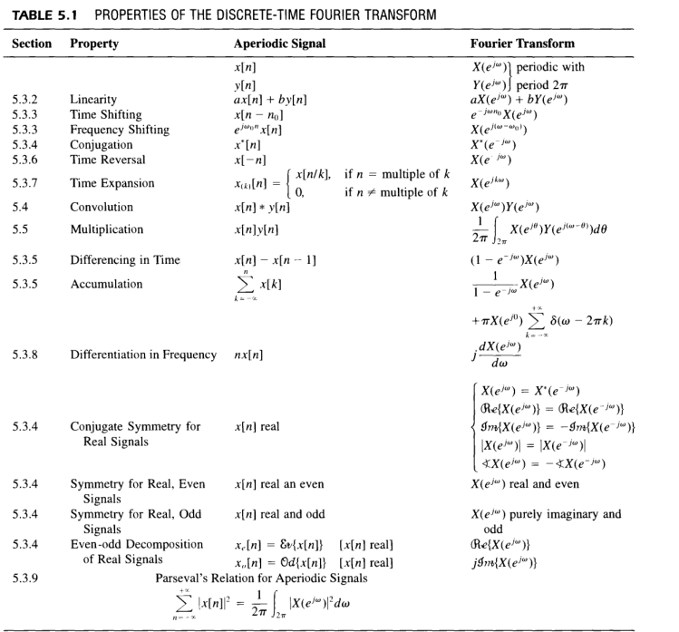
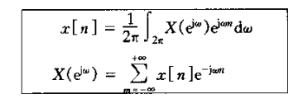
Tutorial 5

Slide 4
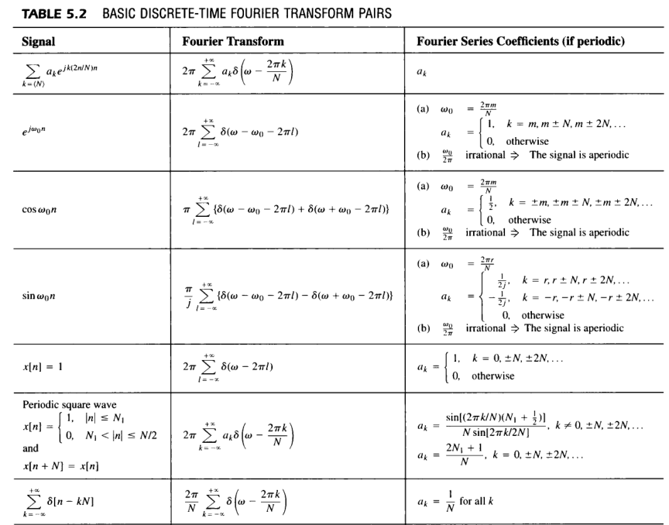
Tutorial 5

Slide 5
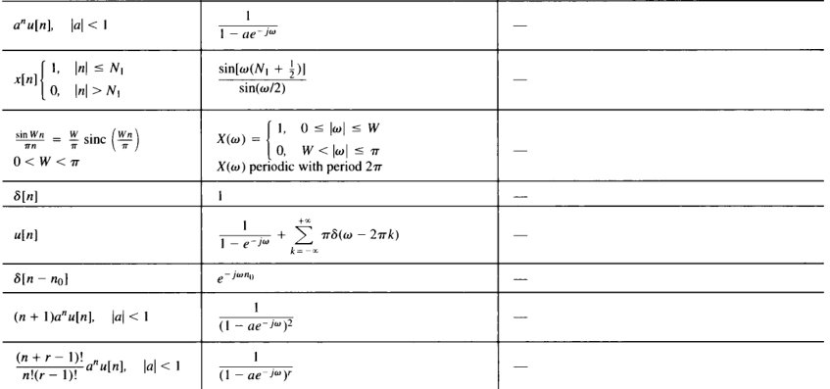
Tutorial 5

Slide 6
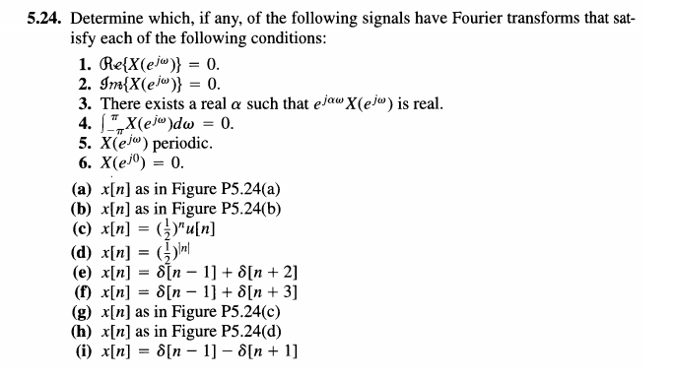
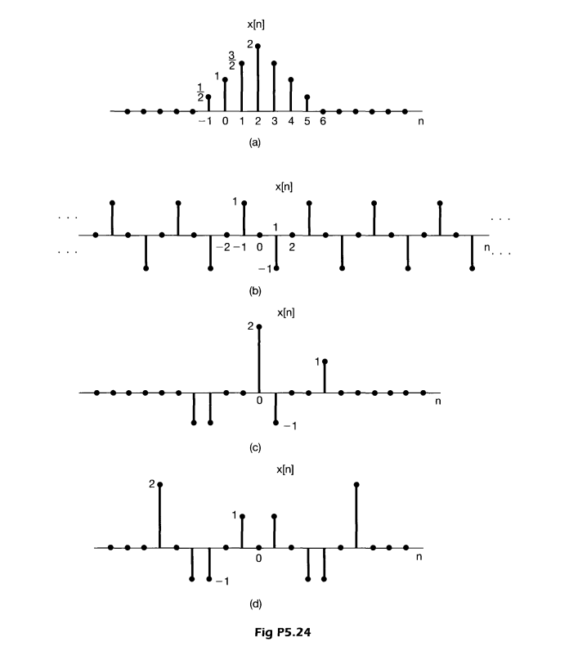
Problem 5.24

Slide 7
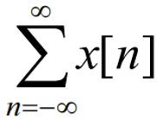
Problem 5.24
real & odd
real & even
real & even after time-shifting
x[0]=0
DT signal
= 0
even
odd, periodic
even
 | 1 | 2 | 3 | 4 | 5 | 6
a |  |  | √ |  | √
b | √ |  | √ | √ | √ | √
c |  |  |  |  | √
d |  | √ | √ |  | √
e |  |  | √ | √ | √
f |  |  | √ | √ | √
g |  |  |  |  | √ | √
h |  | √ | √ | √ | √
i | √ |  |  | √ | √ | √
even
odd

Slide 8
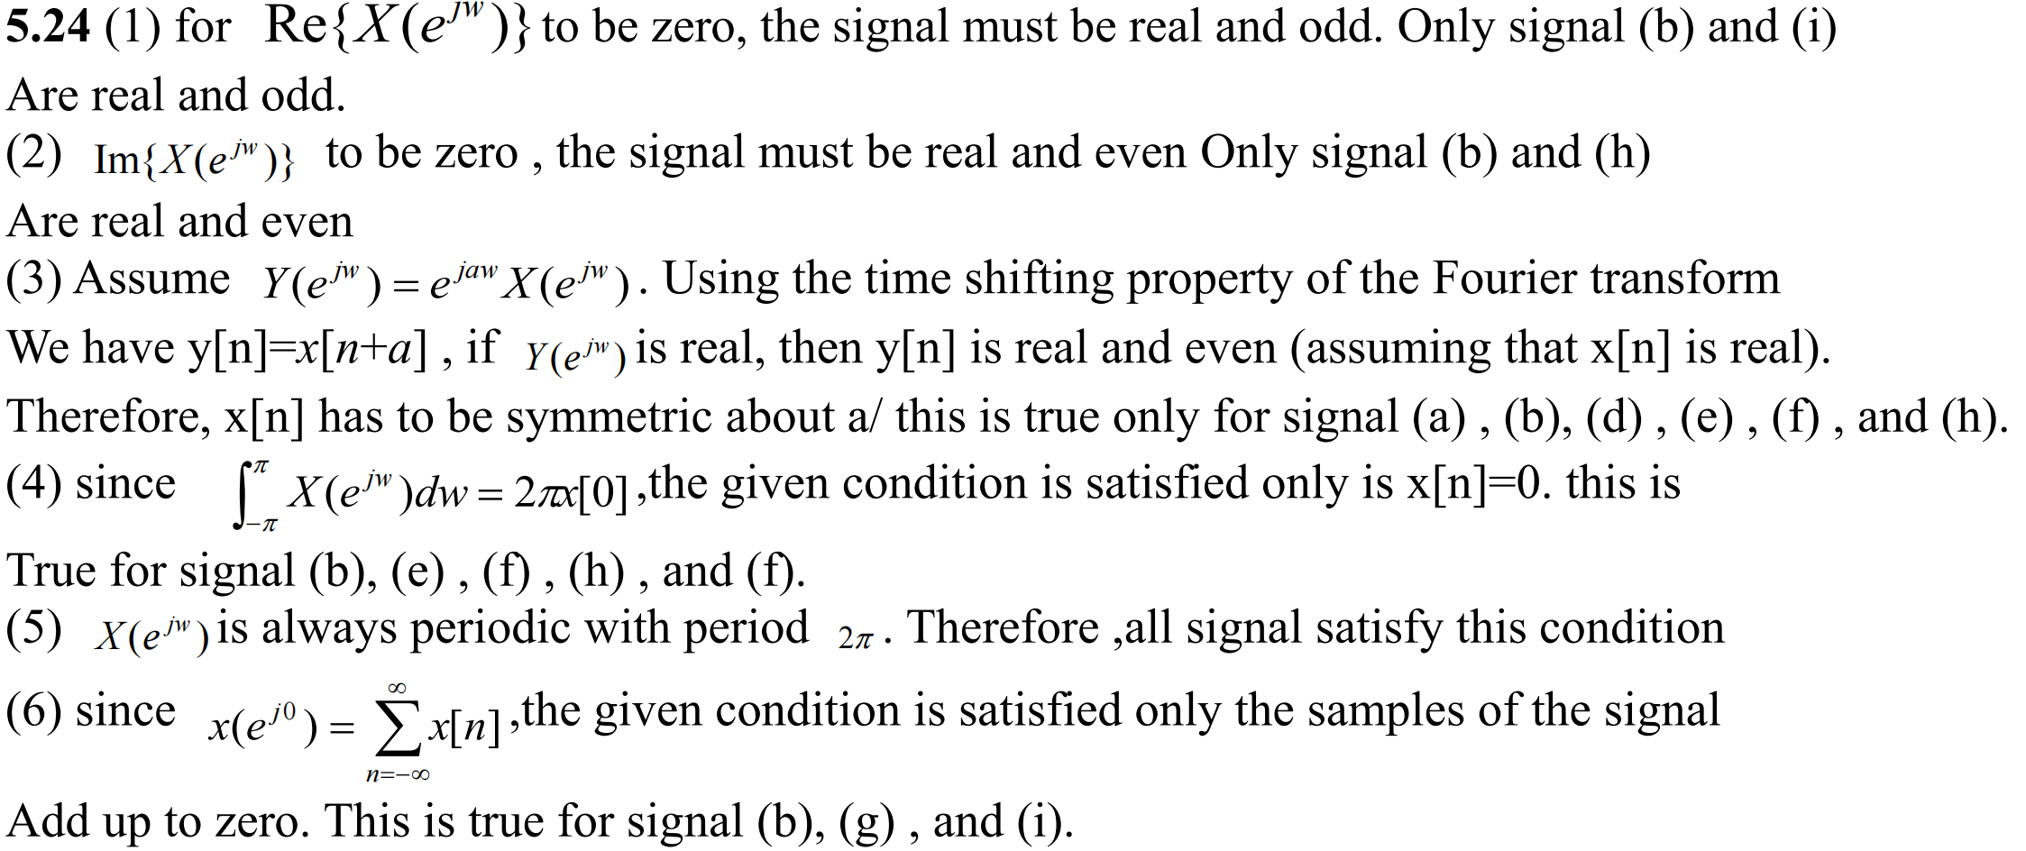
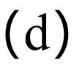
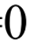
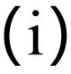
Answer 5.24

Slide 9
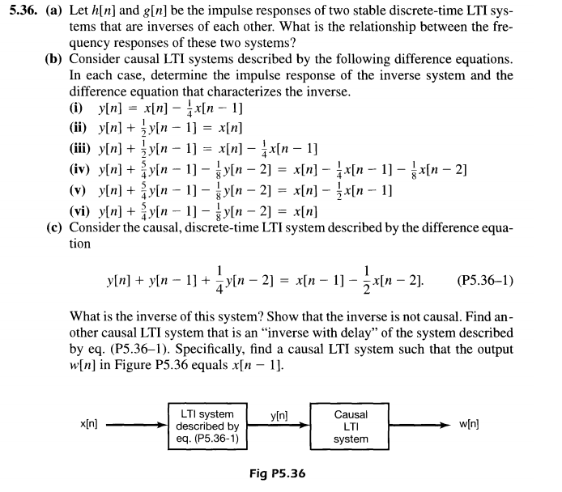
Problem 5.36

Slide 10
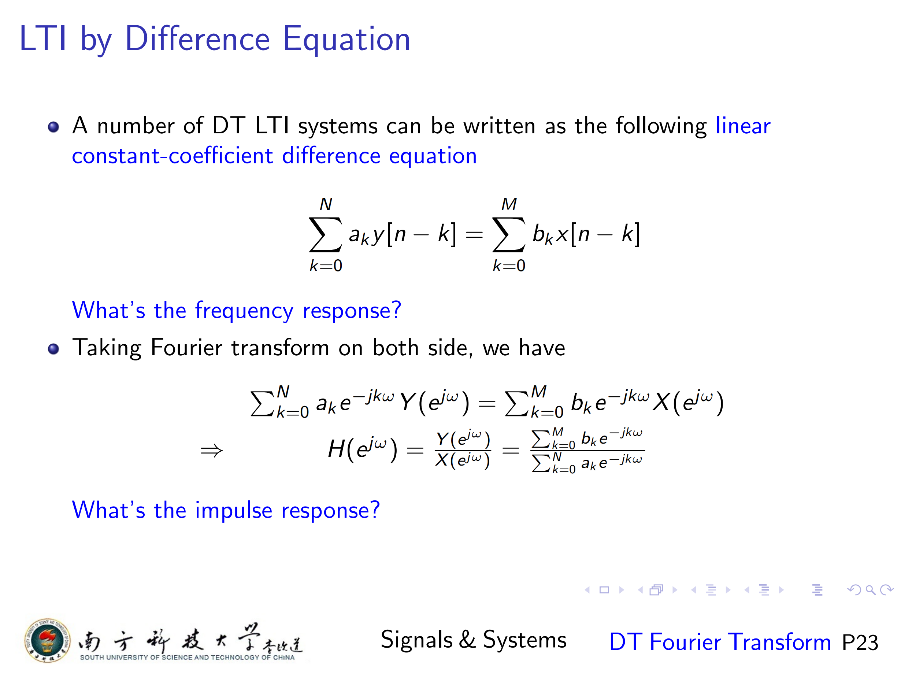

Slide 11

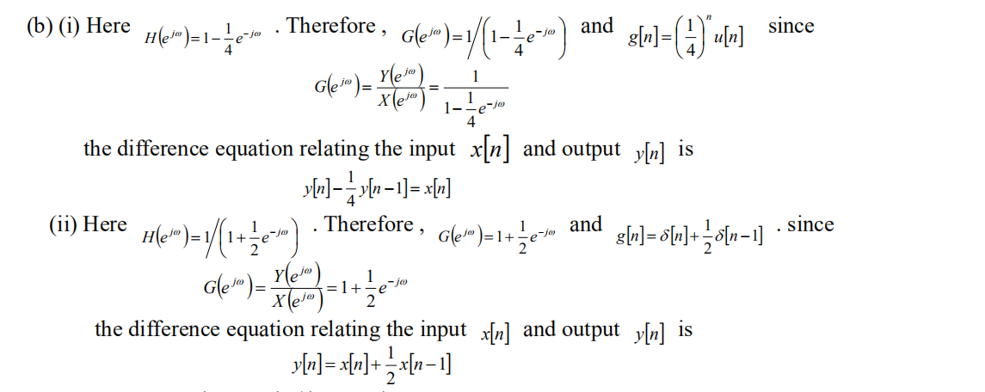
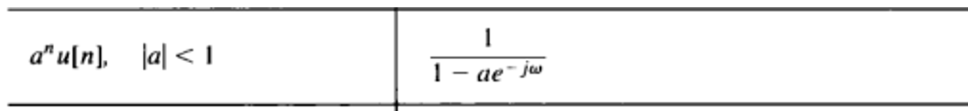
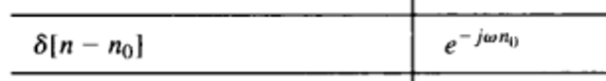
Answer 5.36

Slide 12
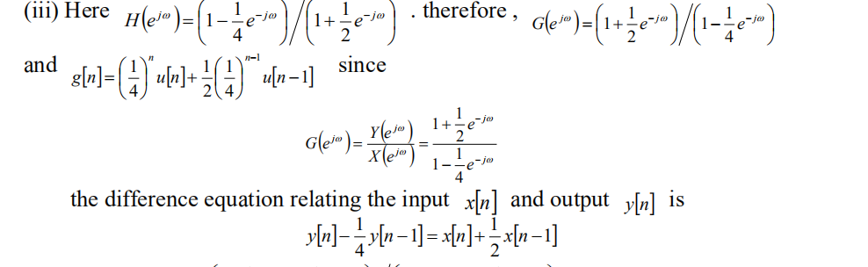
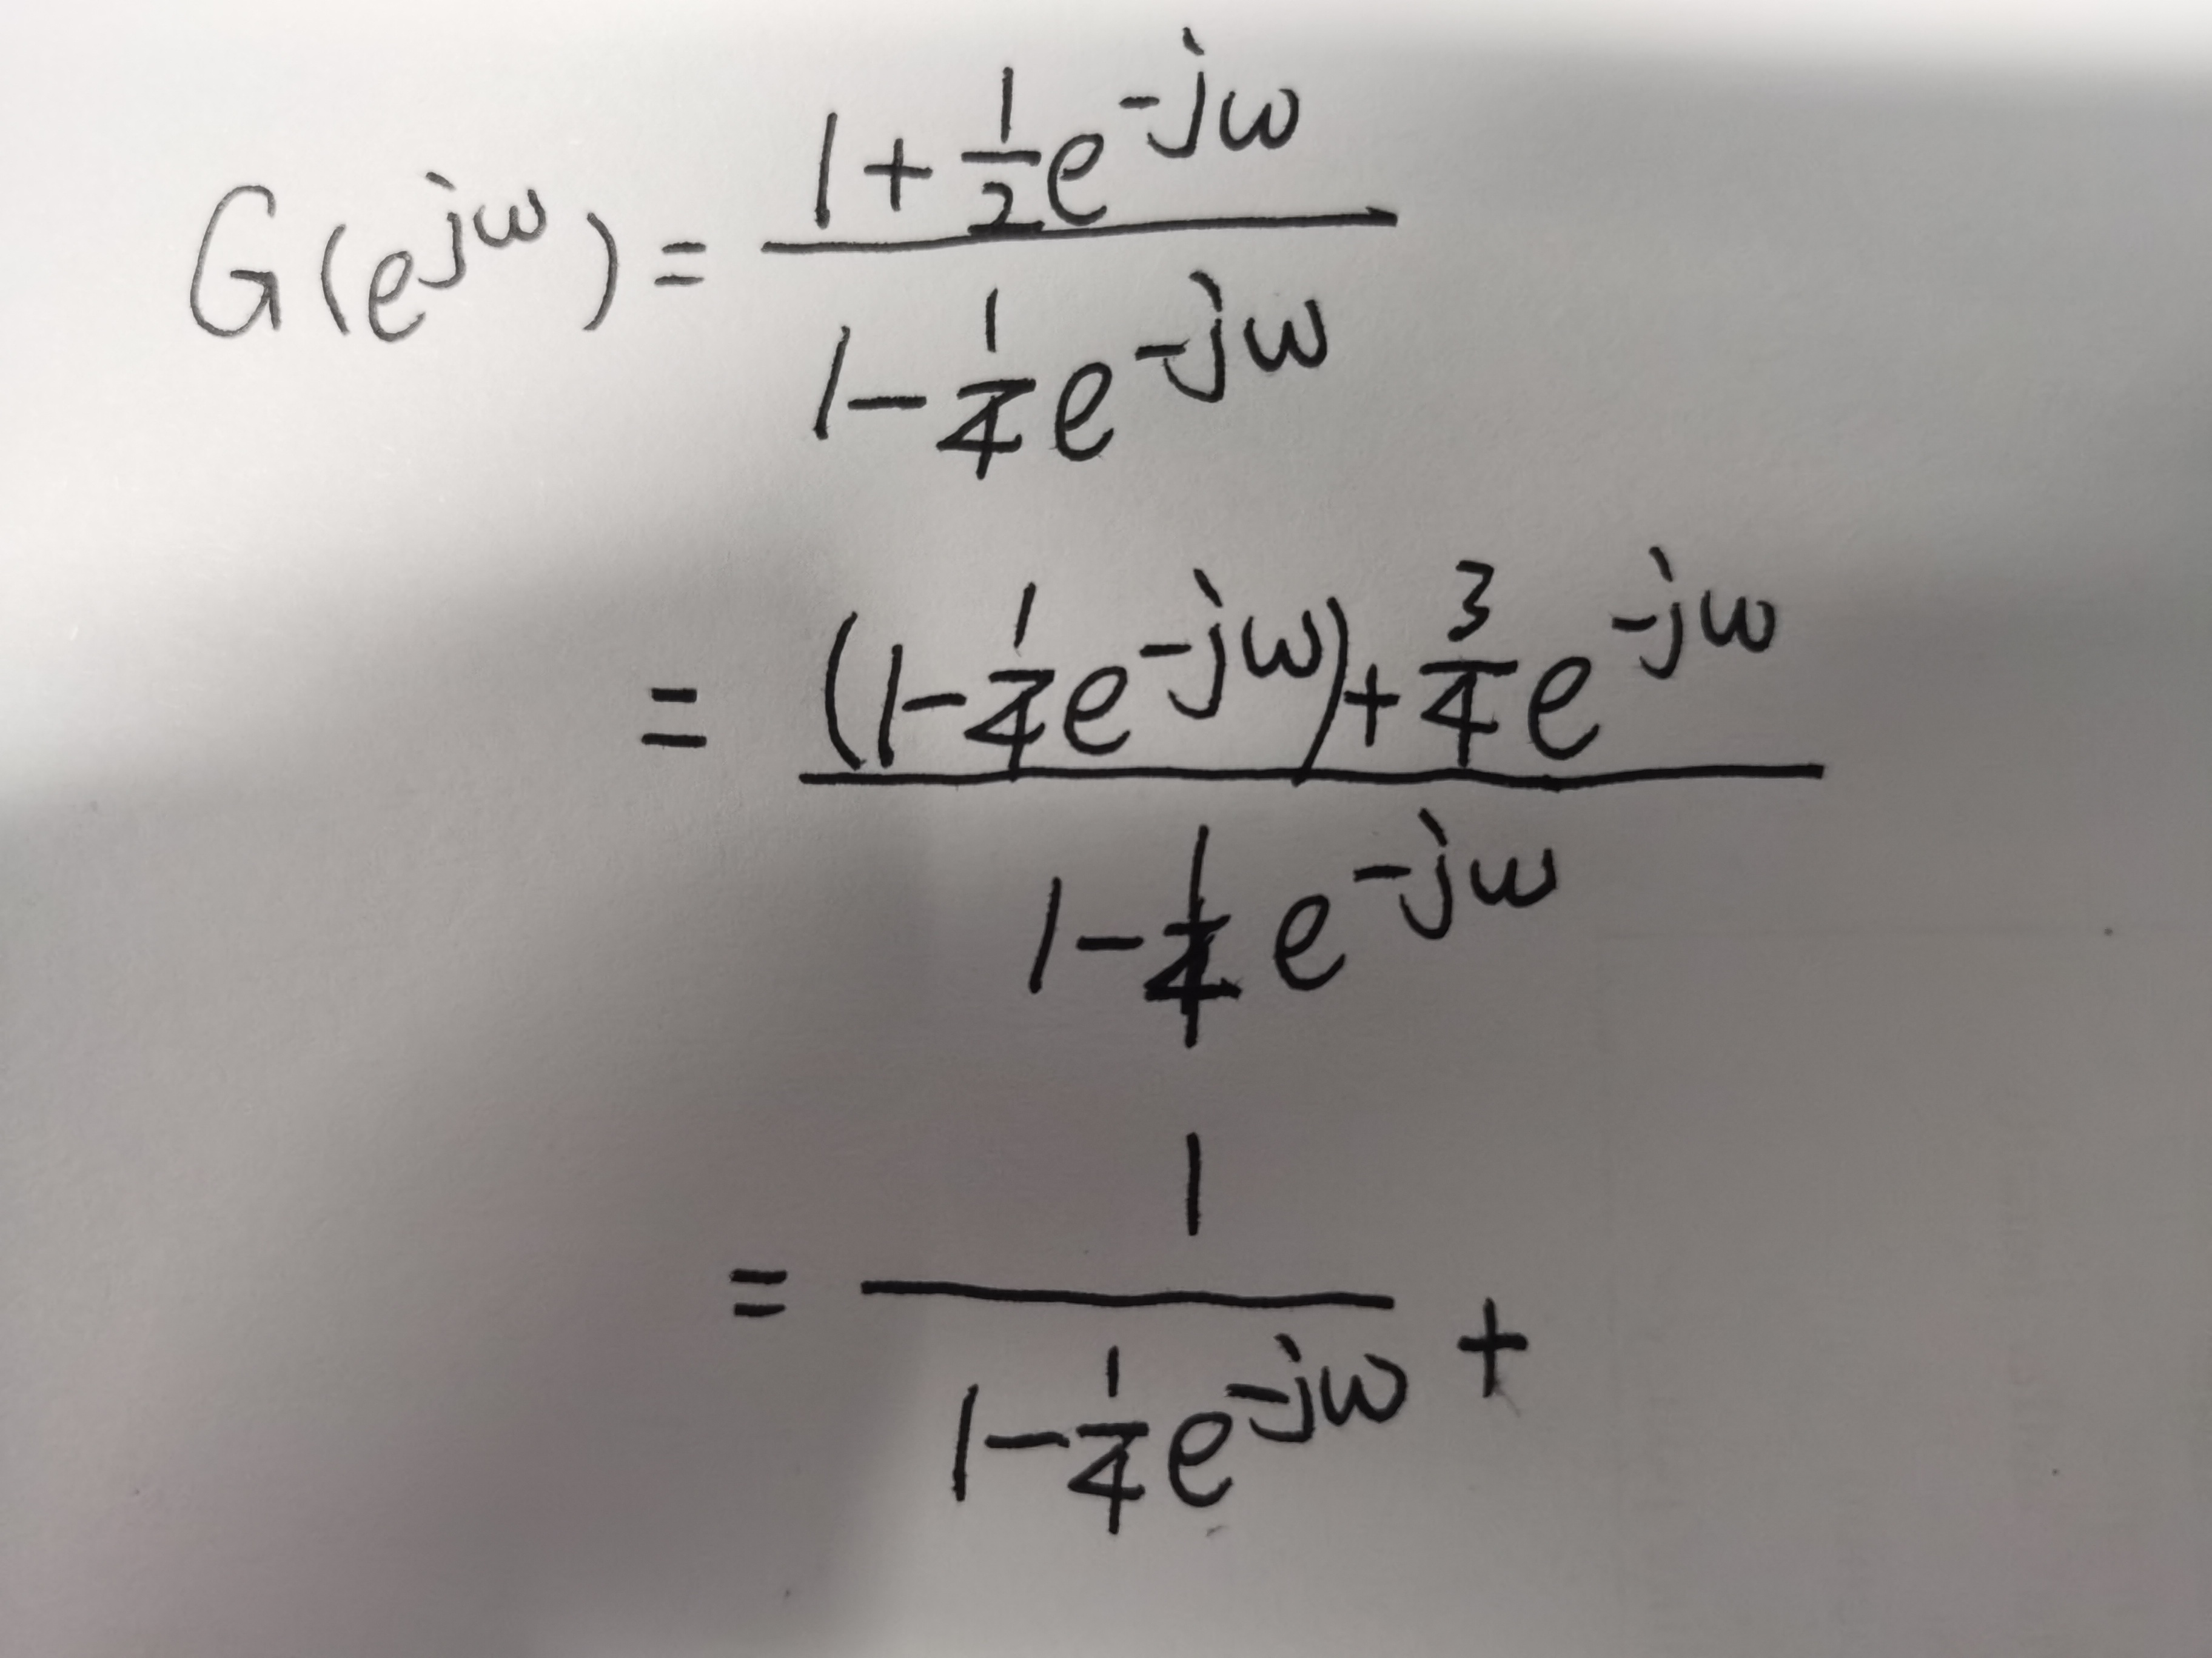
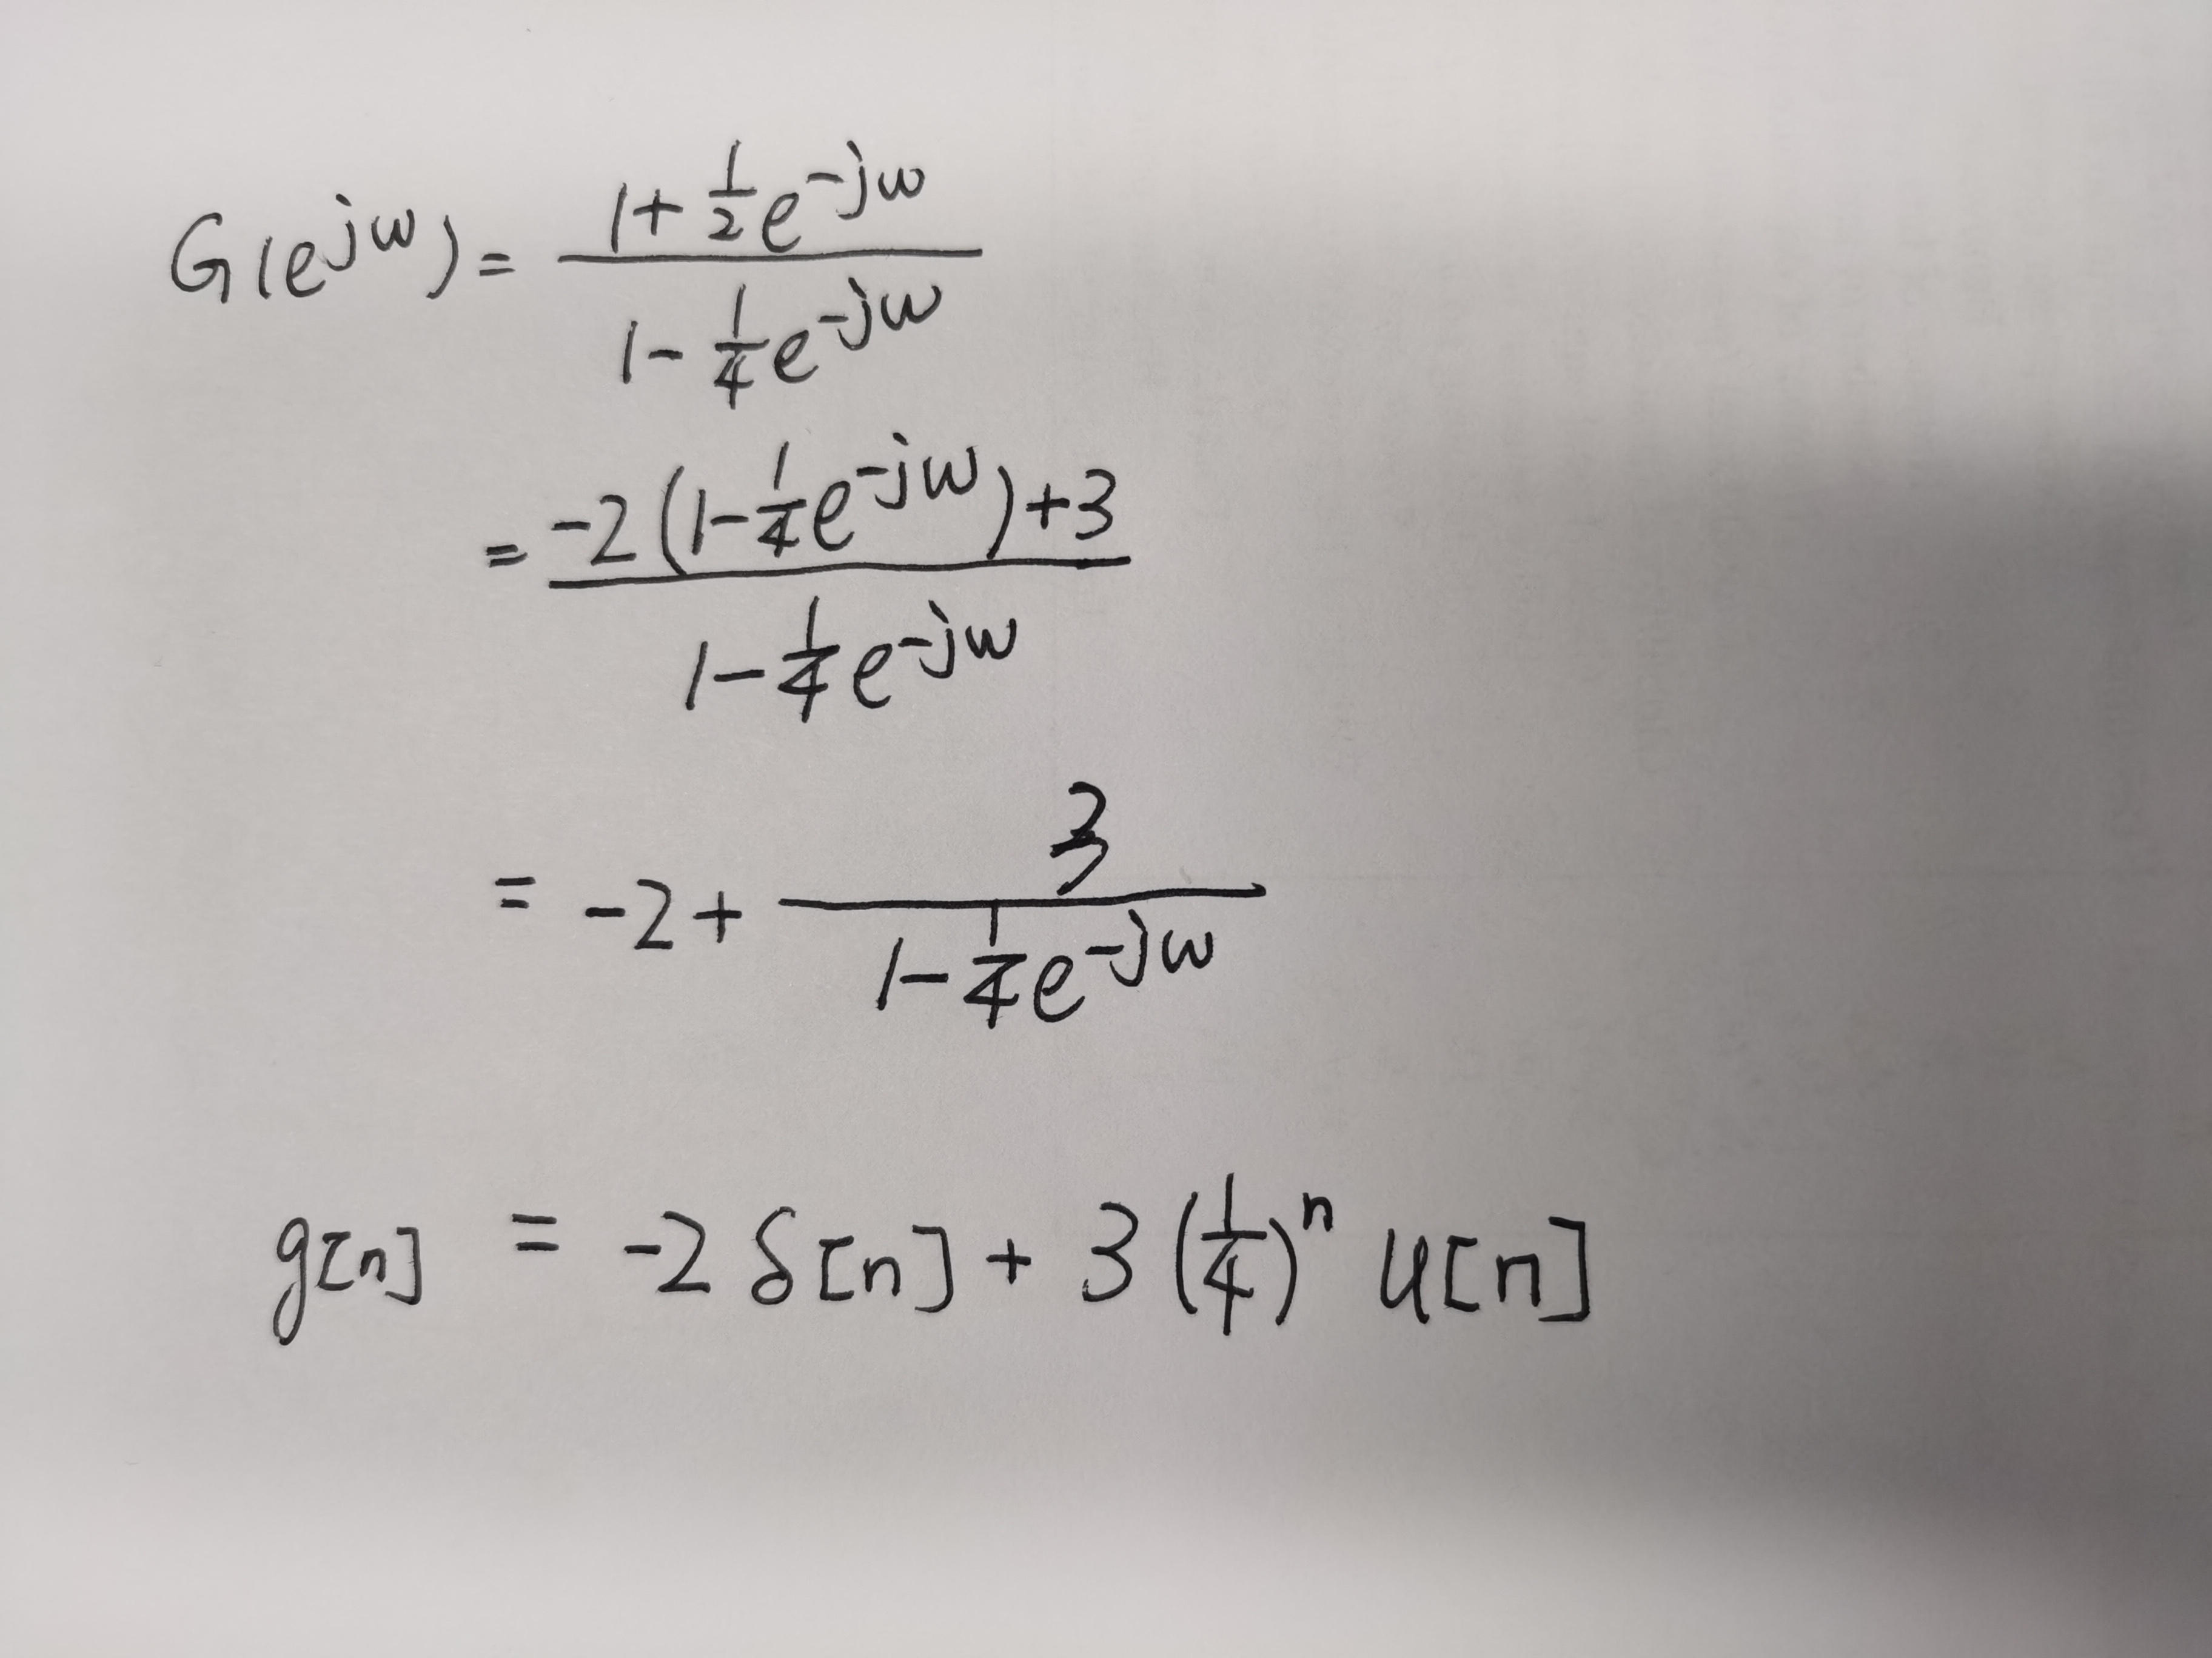
Answer 5.36
since

Slide 13
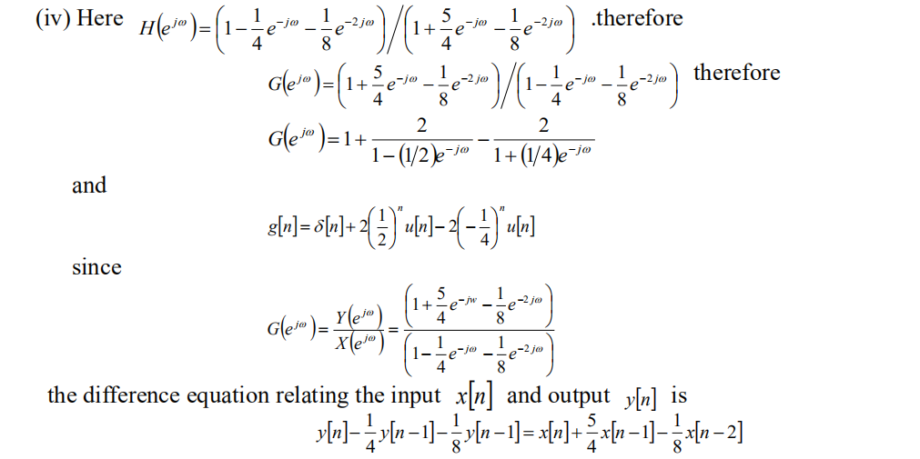
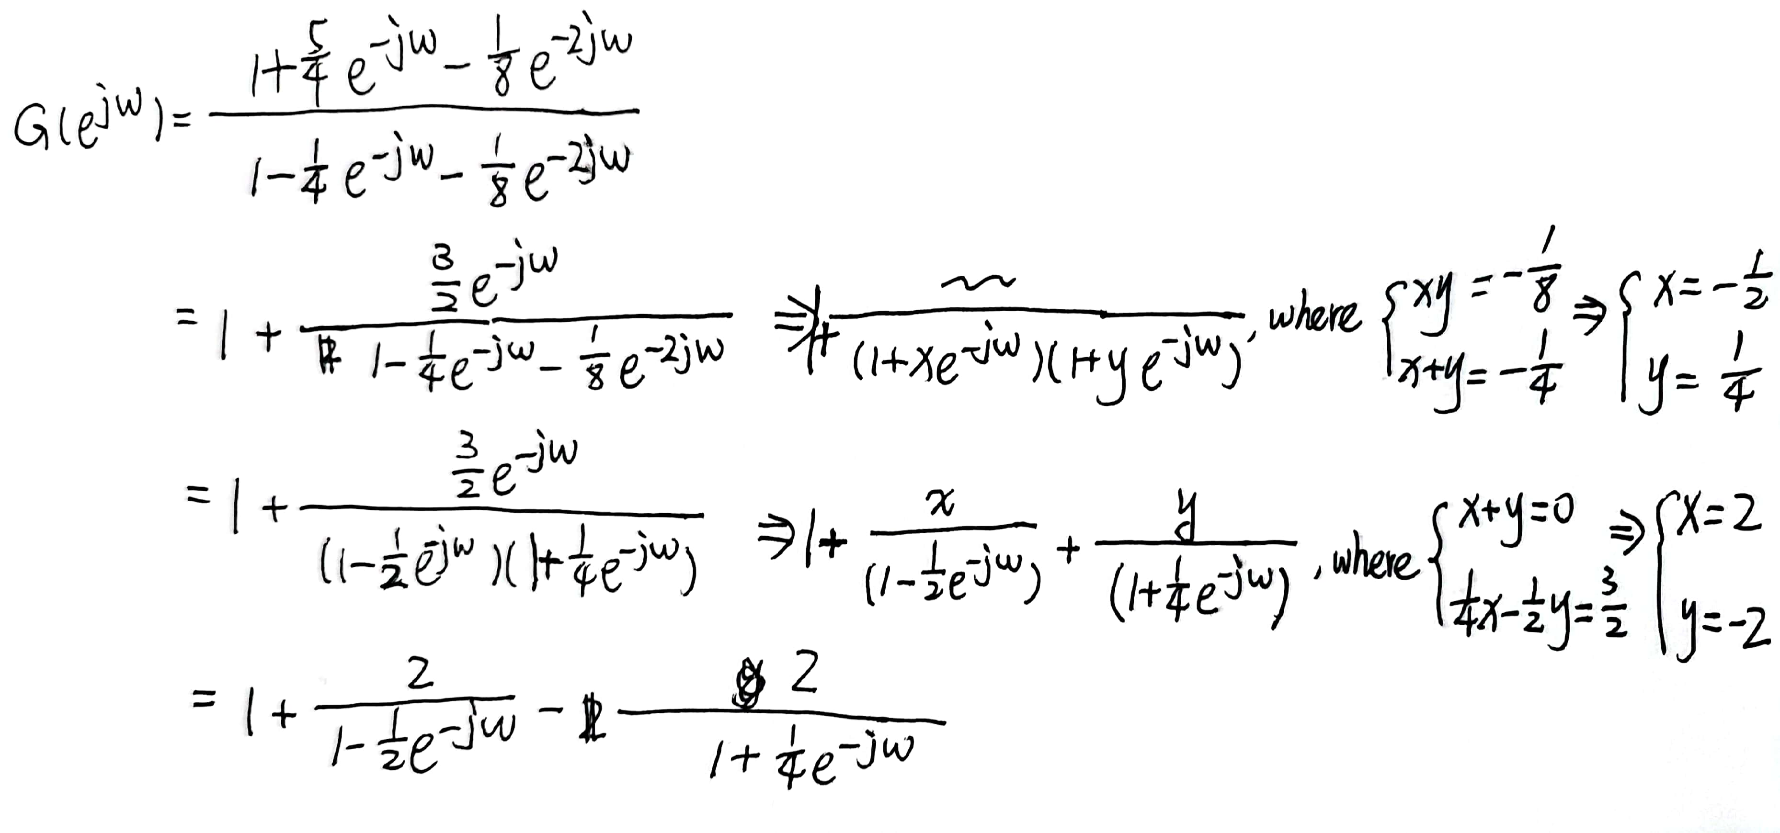
Answer 5.36

Slide 14
Answer 5.36

Slide 15
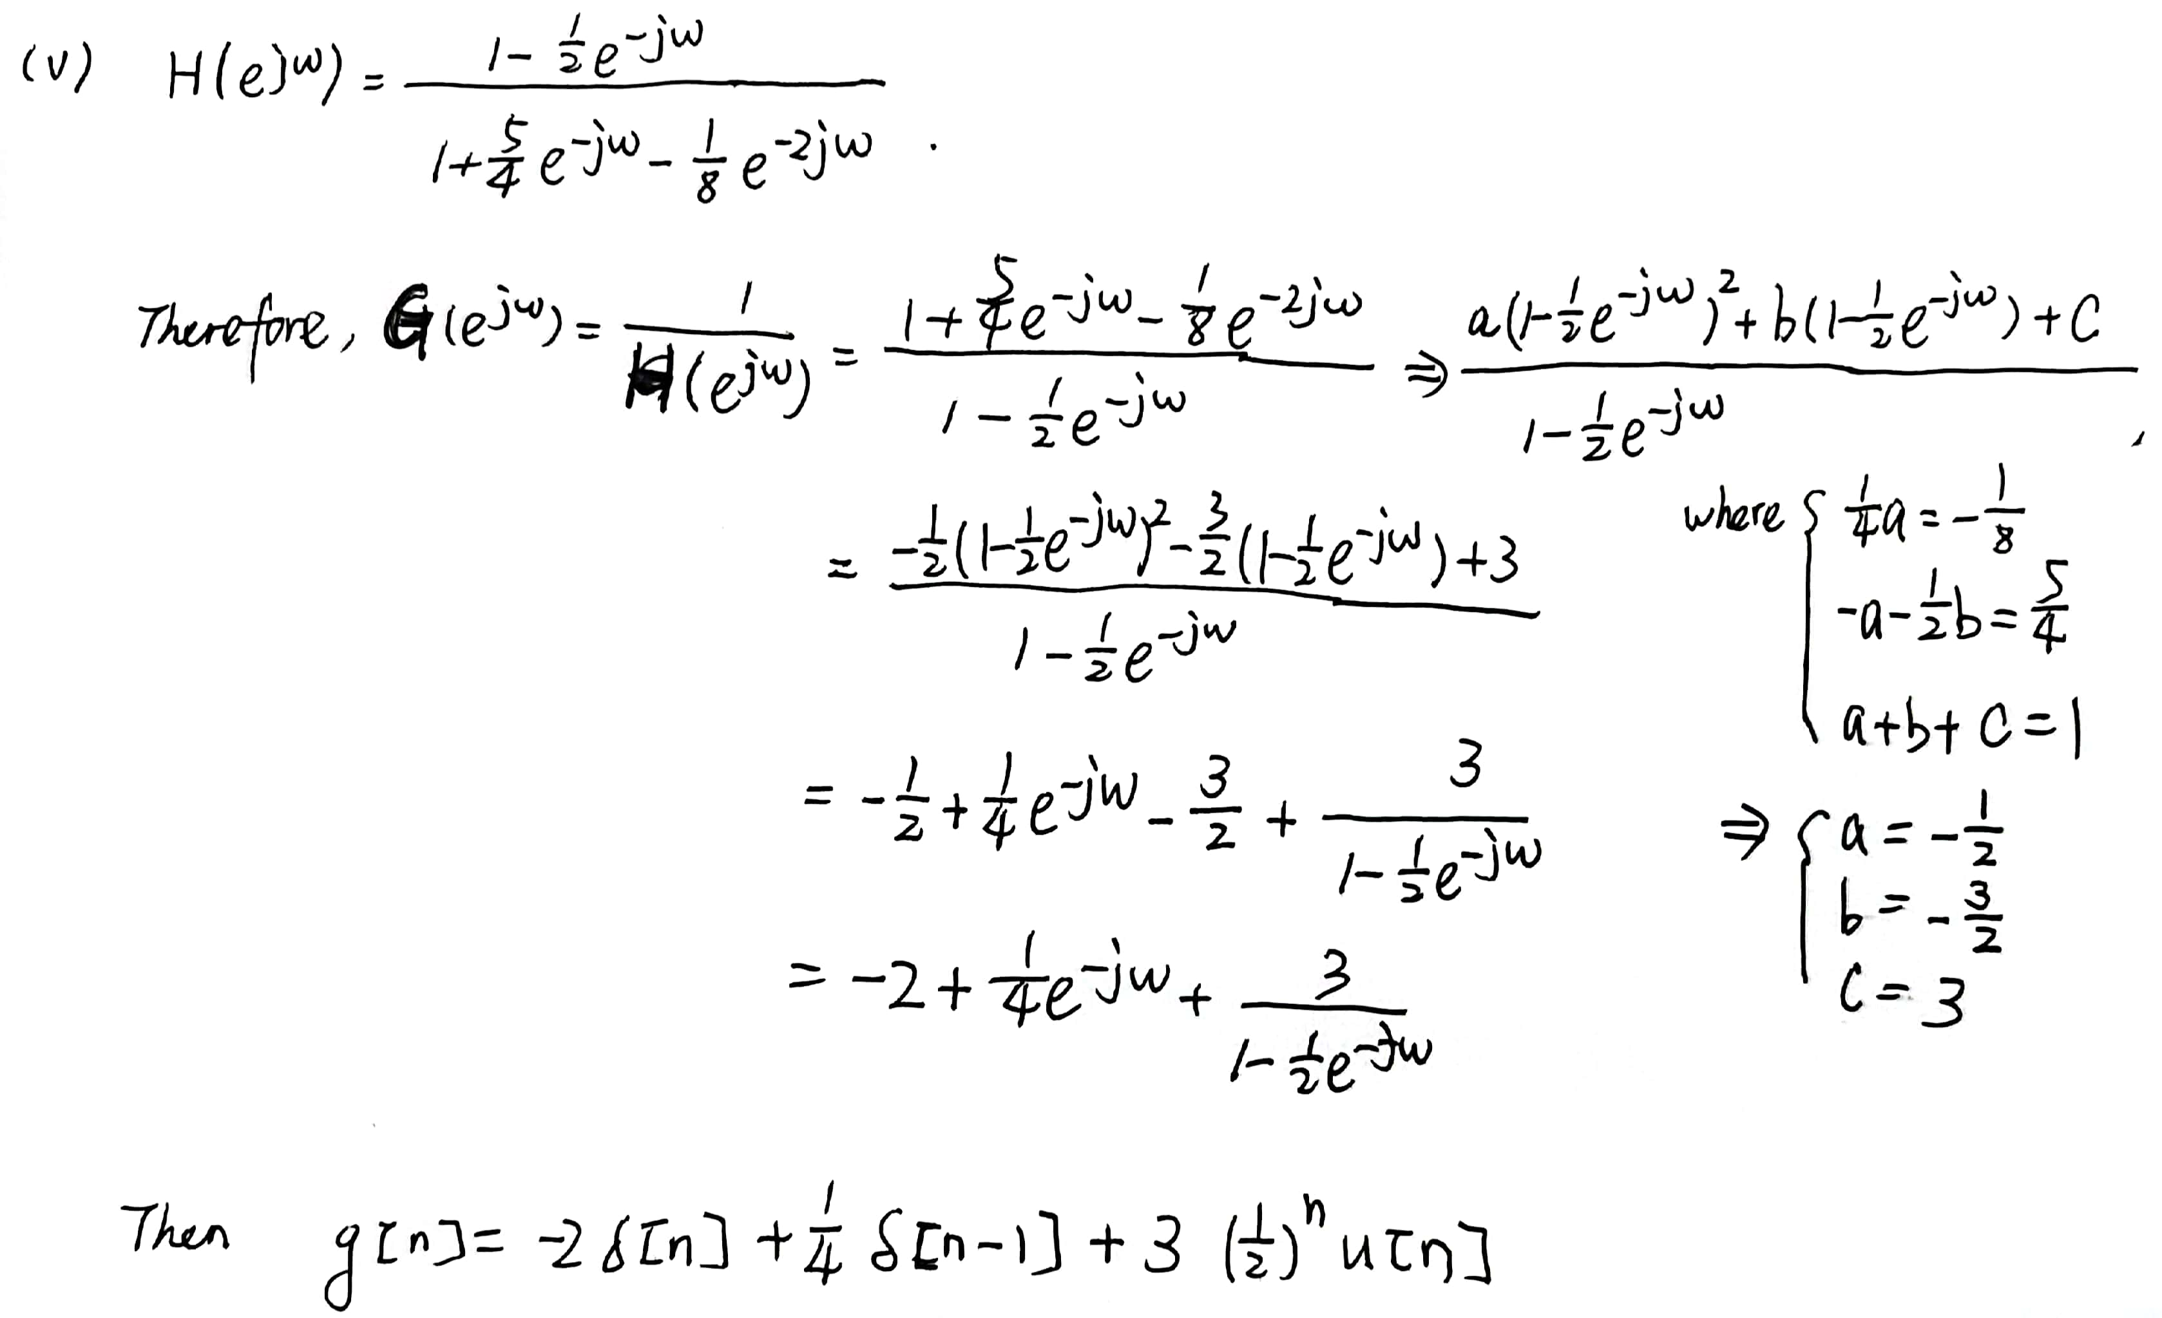
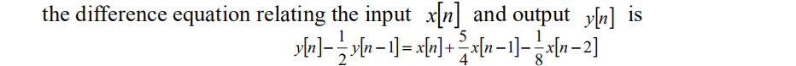
Answer 5.36

Slide 16
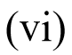
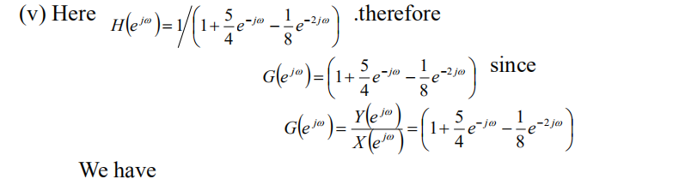
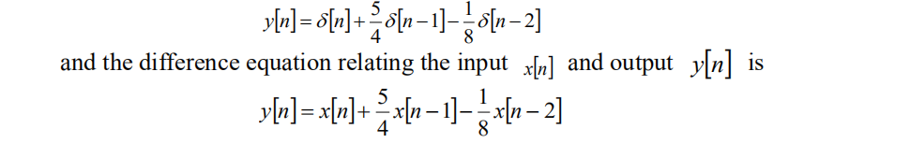
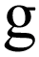
Answer 5.36

Slide 17
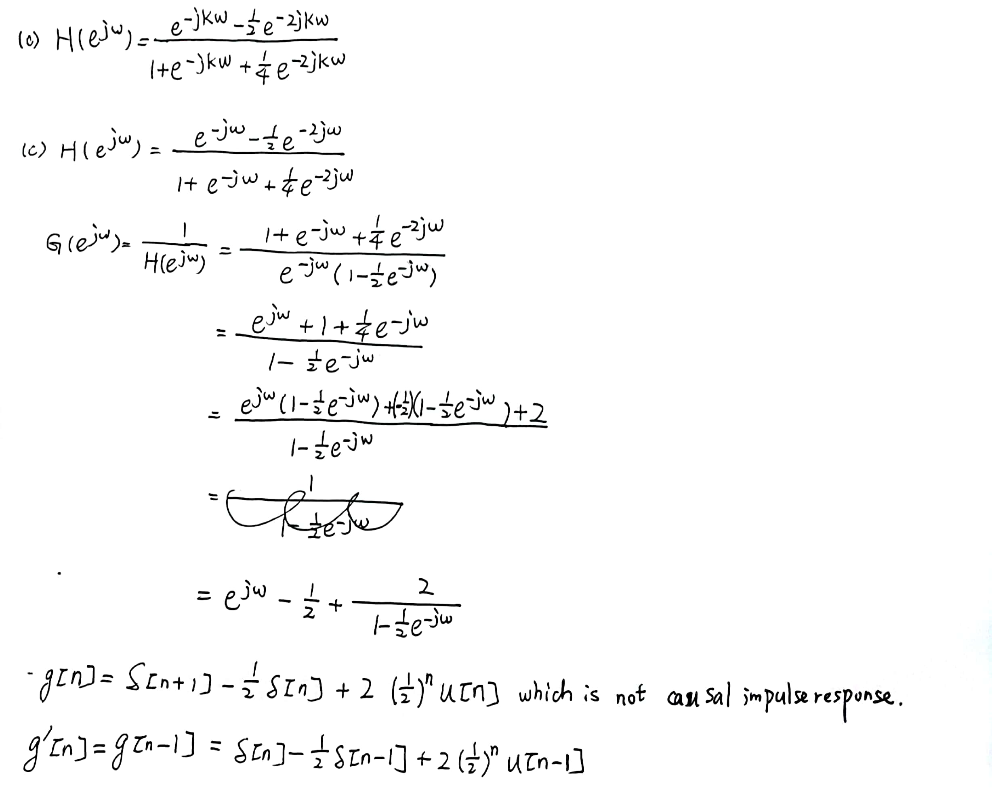
Answer 5.36

Slide 18
Thank you for listening

